Slide 1
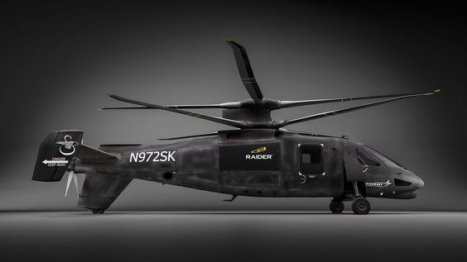
Future Fast Rotorcraft Progress Meeting 01 – 27/09/2023
Y.J.E. Prencipe

Slide 2
Progress Overview Week 1-2
Review of AE4314-21 Lecture Notes
Review of Padfield Introductory Tour
Review of Helicopter Theory by Wayne Johnson
TUD & NLR Expectations
Literature Review Progress
09-10-2020

Slide 3
Key Take-Aways AE4314-21 Notes
09-10-2020

Slide 4
AE4314-21 Notes: Overview
General Layout Helicopters
Hover Performance
Vertical Climb and Descent
Forward Flight
Take-Off and Landing
Flapping Motions
Equations of Motion
Linearized EOMs
Helicopter Trim
Dynamics of Other Rotor Types
→ Mainly old but timeless literature describing the elementary dynamics and performance of helicopters
09-10-2020

Slide 5
AE4314-21 Notes: Flapping Motions
Assumptions
Central flapping hinges without springs, infinitely stiff blades → Solve
Rotor blades have no twist and constant chord → Solve?
Flapping hinges are small such that linearisation is allowed → OK?
Linear aerodynamics, stall effects not included → OK?
Based on blade element theory
Main goal: Deriving the flapping differential equation describing the flapping angle motion
Starting with normal flapping motion, expanded to:
Flapping motion as caused by air turbulence
Control plane having an angular velocity
a0, a1 and b1 can be derived → flapping coefficients
→ Provides good background for derivations in papers

Slide 6
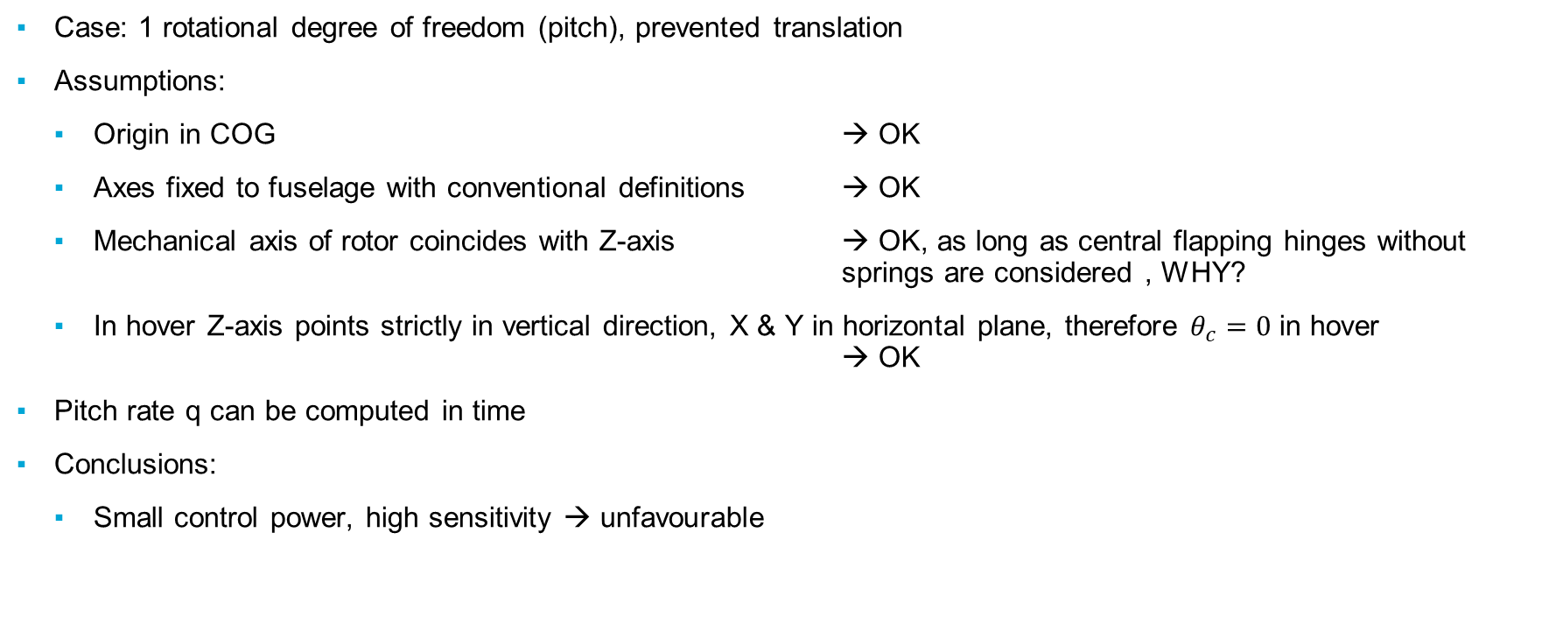
AE4314-21 Notes: Equations of Motion
Case: 1 rotational degree of freedom (pitch), prevented translation
Assumptions:
Origin in COG → OK
Axes fixed to fuselage with conventional definitions → OK
Mechanical axis of rotor coincides with Z-axis → OK, as long as central flapping hinges without springs are considered , WHY?
In hover Z-axis points strictly in vertical direction, X & Y in horizontal plane, therefore $θ_{c}=0$ in hover → OK
Pitch rate q can be computed in time
Conclusions:
Small control power, high sensitivity → unfavourable

Slide 7
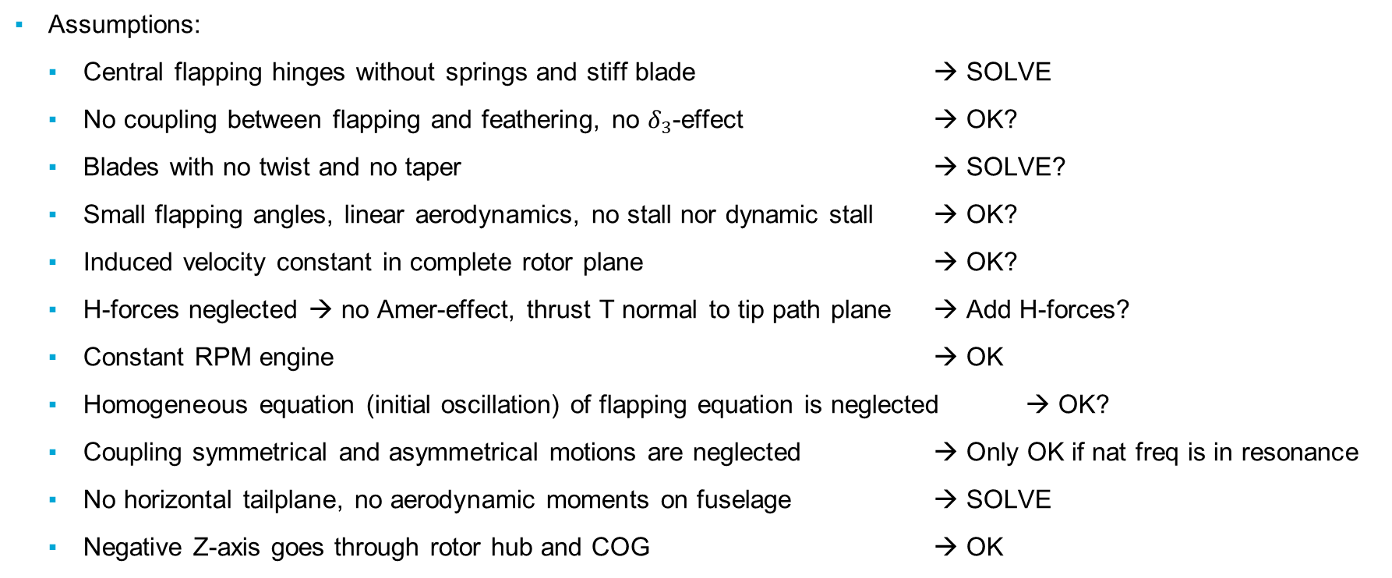
AE4314-21 Notes: 3-DoF Equations of Motion
Assumptions:
Central flapping hinges without springs and stiff blade → SOLVE
No coupling between flapping and feathering, no $δ_{3}$-effect → OK?
Blades with no twist and no taper → SOLVE?
Small flapping angles, linear aerodynamics, no stall nor dynamic stall → OK?
Induced velocity constant in complete rotor plane → OK?
H-forces neglected → no Amer-effect, thrust T normal to tip path plane → Add H-forces?
Constant RPM engine → OK
Homogeneous equation (initial oscillation) of flapping equation is neglected → OK?
Coupling symmetrical and asymmetrical motions are neglected → Only OK if nat freq is in resonance
No horizontal tailplane, no aerodynamic moments on fuselage → SOLVE
Negative Z-axis goes through rotor hub and COG → OK

Slide 8
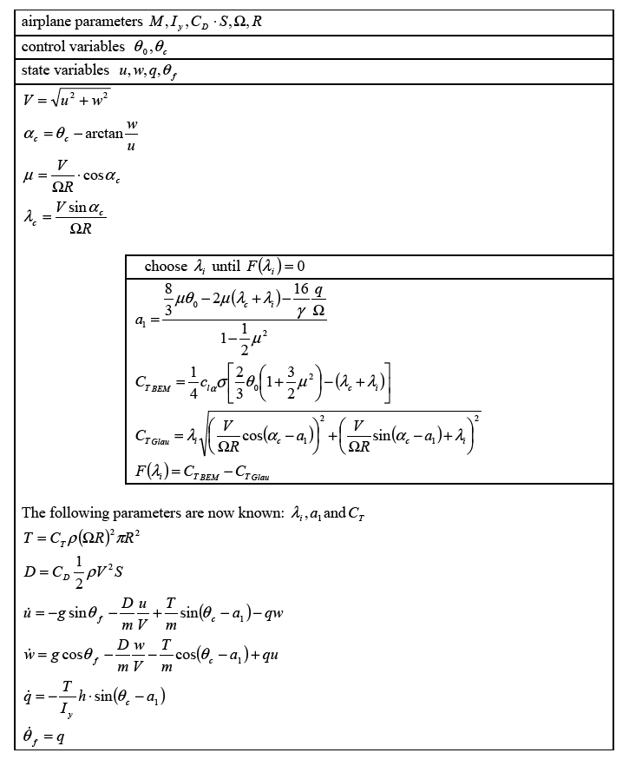
AE4314-21 Notes: 3-DoF Equations of Motion
Assumptions (2):
Motions take place in plane of symmetry of helicopter → only moment of inertia about y-axis is important → OK
A computation scheme for symmetrical motion simulation (heave, surge, pitch) is derived

Slide 9
AE4314-21 Notes: Trim
Matrix system is derived in order to find collective and cylic angles for varying airspeeds
The EOMs in symmetrical flight with corresponding assumptions was used to derive the matrix system → reduced to equations of trim
Conlusions:
Cyclic pitch is statically stable
Collective varies in same way as power required → engine regulation is often realized through mechanical coupling of gas and collective lever
Trim is an important aspect for analysing and comparing the contributions of lateral and longitudinal cyclic and collective in various helicopter configurations with or without various control schemes

Slide 10
AE4314-21 Notes: Dynamics of Other Rotor Types
5 Different rotor types are analysed:
Central hinged, with spring, stiff
Hinge offset, stiff
Hinge offset, with spring, stiff
Flexible blade
Flapping dynamics and natural frequencies are analysed for all types
Analysis of the motions of the fuselage with a rotational degree of freedom
Flapping coefficients and pitch rate calculation
Springs lead to better control performance → much better “control power”

Slide 11
Key Take-Aways Padfield FD
09-10-2020

Slide 12
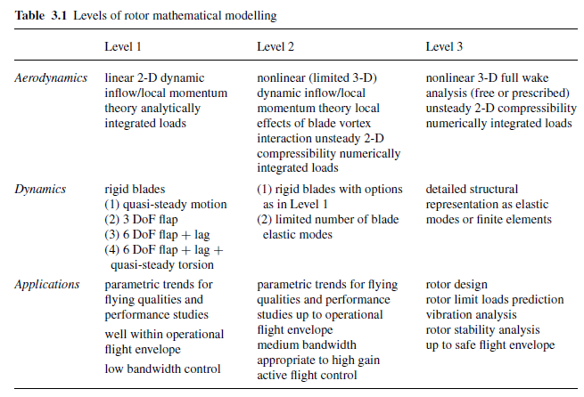
Padfield: Modelling
Model selection Criteria → Level 2 seems good
Appropriate-High gain active flight control
3/6Dof → 6 in final work
Lag → little contribution for ABC [Yuan, 2019]
Quasi-steady torsion tbd

Slide 13
Padfield: Flying Qualities
Handling Quality Parameters:
Quickness
Bandwidth
CAP
Pitch dropback

Slide 14
Padfield: Control
Some very good takeaways at p80-81
Impurity of primary responses
Strong cross-couplings
Response degradation at flight envelope limits
Poor stability
Control actuator gain limited to 0.2 (p82)
‘ACT’ (Active Control Technology) in helicopters

Slide 15
Helicopter Theory - Wayne Johnson
09-10-2020

Slide 16
Wayne Johnson: Modelling
Overall very good book to read after the lecture notes, solidifies the ideas brought up in the notes, a lot more readable compared to Padfield
Chapter 2 expands on several topics for blade element theory:
Tip loss factor explanation (in the lecture notes a value of 0.97 is given, but not explained)
Linear & ideal blade twist effects
Non-uniform inflow distributions (linear inflow)
Root cutout (only has a very small effect]
Equivalent solidity
A comparison of results is given on p71
Touches upon several other topics such as the ideal rotor concept, ideal rotor design, and vortex theory (maybe too in depth]

Slide 17
NLR & TUD Expectations
09-10-2020

Slide 18
NLR & TUD: Expectations
NLR
Modelling: Use their in-house non-linear FlightLab model
they also have a non-linear X2 model
Discussion is happening concerning if we are authorised to use the real model or X2 model
Controller: High-level controller using control allocation (applied on the linear model]
- make a trade-off of different control strategies suitable for the rotorcraft
Handling Quality Analysis: Initial assessment during early design phase, identify applicable HQ assessment criteria to consider during early design of these rotorcraft types
TUD
Modelling: unclear → develop a Level 2 nonlinear model based on literature? → Develop 6 DoF Compound Model
Controller: unclear → apply a nonlinear controller e.g. INCA, INDI, … ? → Do control allocation, simple controller
HQ Analysis: unclear → general assessment of HQ and identification of applicable HQ criteria? → this would be in-line with TUD

Slide 19
NLR & TUD: Proposed Solution
Start with basics from NLR, expand upon this according to time available and TUD academic level
Expansion possible on following topics:
Flight Model Expansion
Flight Controller Expansion based on Nonlinear X2 Model
Very important to have analytical mathematical understanding of the system

Slide 20
Literature Review Progress
09-10-2020

Slide 21
Literature Review Progress
See Word document
General
FVL program – FLRAA, FARA, ITEP
History of coaxial rotor – pusher propeller compound designs(in progress)
Design Aspects
Coaxial Rotors and Pusher Propellers
Compound Designs
ABC Rotors
Modelling
Rotor thrust&power
Inflow
Flapping dynamics

Slide 22
Literature Review Progress
Propeller model
Aerodynamic forces and moments
Validation
Control
Trim analysis
Architecture – inner vs outer loop schemes
Linear and Nonlinear control methods
Control allocation techniques
Handling Qualities
ADS-33E/F-PRF
MTE Manoeuvres, Quantitative HQ metrics, validation

Slide 23
Thesis Timeline
09-10-2020

Slide 24
Thesis Timeline
More detailed once proper project boundaries are established
See Excel file

Slide 25
End of Presentation.
Ynias J.E. Prencipe

